Slide 1
Chapter V.
Automating Tasks and Shell Scripting
LINUX AND OPEN SOURCE SOFTWARE
Department of Computer Engineering and Electronics

Slide 2
Main contents
What is Shell?
Basic Shell Control
Scheduling Tasks
Writing and Executing a Shell Script

Slide 3
What is Shell?
Shell:
  A program/environment that users employ to type commands, run programs and shell scripts.
    It gathers input from you and executes programs based on that input. When a program finishes executing, it displays that program's output.
  An interface to the Unix system.
  An command-line interpreter that ﻿supplies both a command language and a program scripting language that help to control the operating system.

Slide 4
What is Shell?
Shell:
  Several shells in UNIX are:
    Bourne Shell (sh) => Become standard to all UNIX/Linux shells
    Bourne-Again Shell (bash) => ﻿a GPL-licensed version of the Bourne Shell with some enhancements, standard in Ubuntu
    Z Shell (zsh) => Default shell in macOS
    C Shell (csh) => Writing based on C programming language

Slide 5
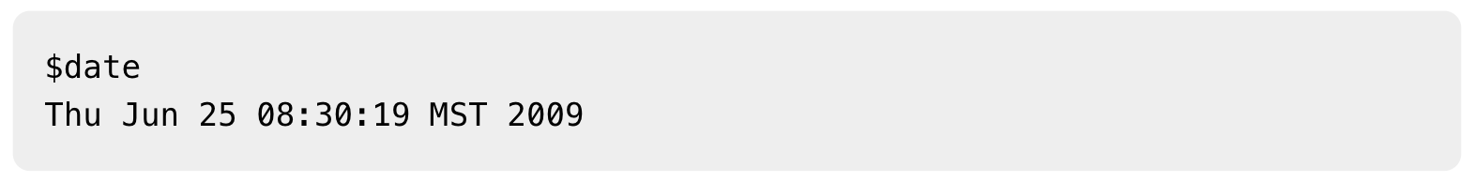
What is Shell?
Command prompt:
  The prompt, $, which is called the command prompt, is issued by the shell. While the prompt is displayed, you can type a command.
  C Shell uses % as the command prompt
  Bourne shell is usually installed as /bin/sh on most versions of Unix.

Slide 6
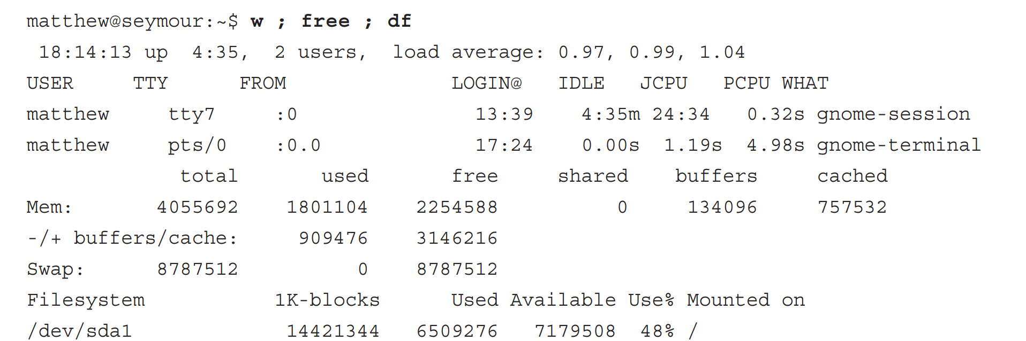
Basic Shell Control
Shell Command Line:
  Searching files, directories, getting data and writing data to files
  Launch command line as background process, suspend running programs, process control
  We can run multiple commands on a single command line using semicolon

Slide 7
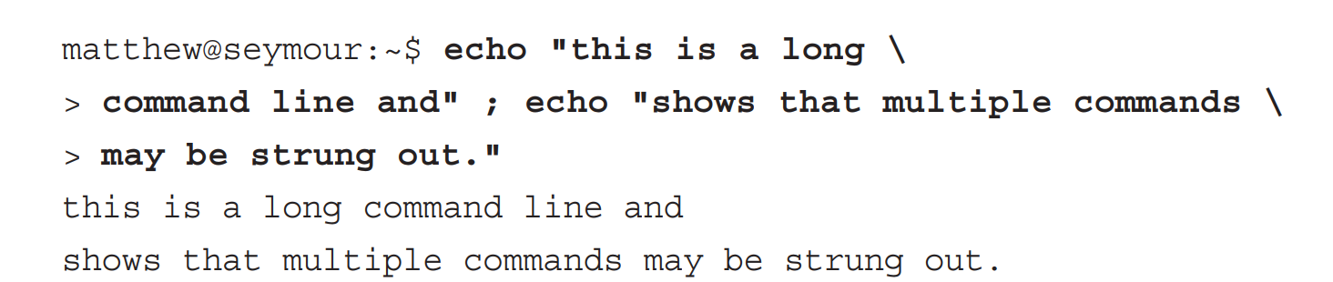
Basic Shell Control
Shell Command Line:
  Using the basic features of the shell command line is easy, but mastering the use of all features can be difficult
  We can extend long shell command lines inside shell scripts or at the command line by using the backslash character (\), as follows:

Slide 8
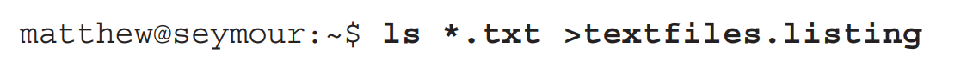
Basic Shell Control
Redirecting Input and Output:
  ﻿You can create, overwrite, and append data to files at the command line, using a process called input and output redirection.
  The shell recognizes several special characters for this process, such as >, <, or >>.
Output redirection
Append
Input redirection

Slide 9
Basic Shell Control
Piping Data:
  ﻿Stringing together Linux commands in this fashion is known as using or creating pipes.
  Pipes are created on the command line with the bar operator (|)

Slide 10
Basic Shell Control
Shell Pattern-Matching Support:
  ﻿grep supports shell pattern-matching which is a simpler version of regular expressions
  Search through files, directories or filter data input/output of commands

Slide 11
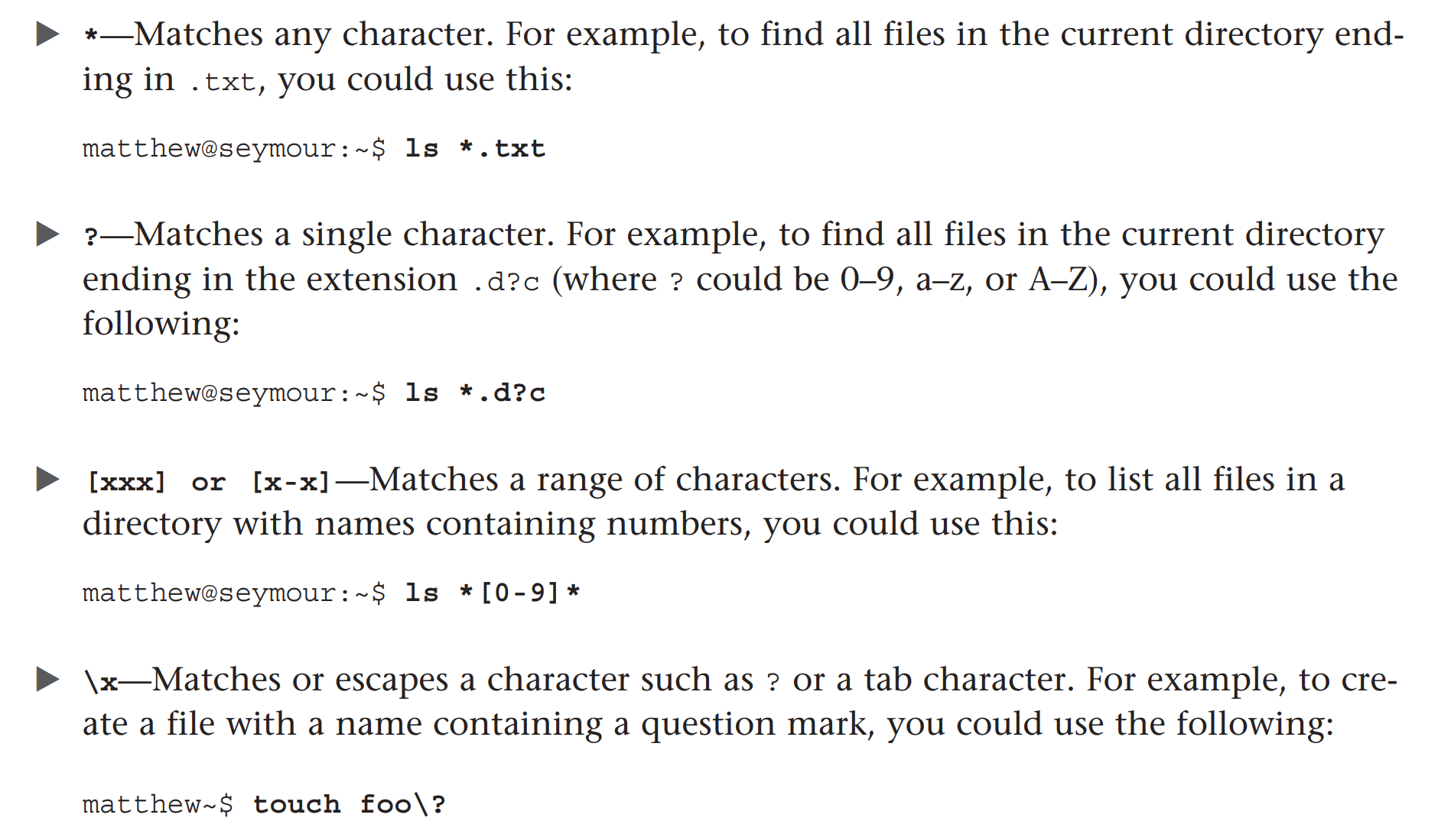
Basic Shell Control
Shell Pattern-Matching Support:

Slide 12
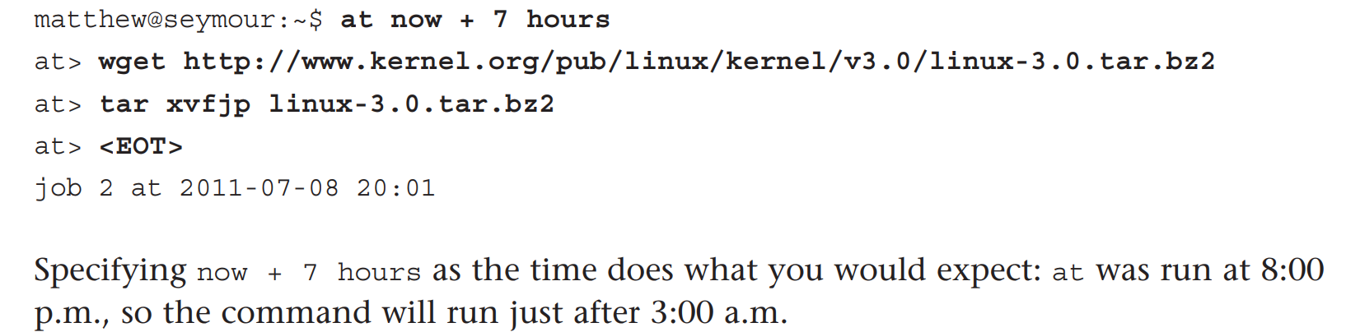
Scheduling Tasks
﻿ Three ways to schedule commands in Ubuntu:
  at command
  batch command
  cron daemon

Slide 13
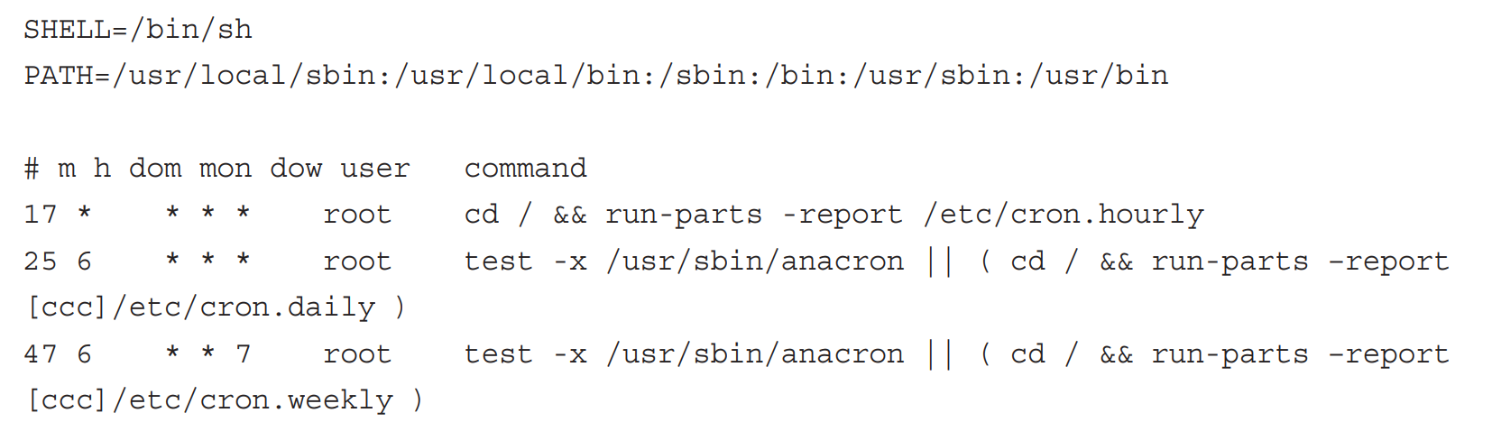
Scheduling Tasks
﻿ Cron Daemon:
  at and batch ﻿work well if you just want to execute a single task at a later date, but they are less useful if you want to run a task frequently.
  ﻿cron daemon exists for running tasks repeatedly based on system (and user) requests.
  ﻿System jobs are controlled through the /etc/crontab file

Slide 14

Scheduling Tasks
﻿ Cron Daemon:
  ﻿To edit your own crontab file, type crontab -e.
  ﻿By default the editor is vim, also known by its older name vi
    ﻿A personal job to empty sandbox directory every morning at 6:00 a.m.
  By crontab -r to delete your crontab file.

Slide 15
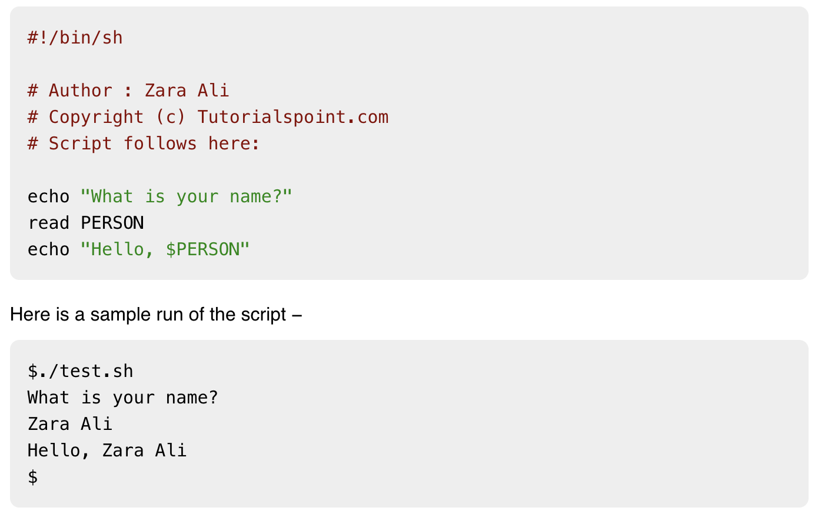
﻿Writing and Executing a Shell Script
Shell Script
  Shell script is a list of commands, which are listed in the order of execution. A shell script is a computer program designed to be run by the Unix/Linux shell

Slide 16
﻿Writing and Executing a Shell Script
Why should you write and use shell scripts?
  Shell scripts can save you time and typing, especially if you routinely use the same command lines multiple times every day.
  ﻿A shell program can be smaller in size than a compiled program.
  ﻿Shell program does not require any additional library support other than the shell.
  ﻿The process of creating and testing shell scripts is also generally simpler and faster than the development process for equivalent C language commands.

Slide 17
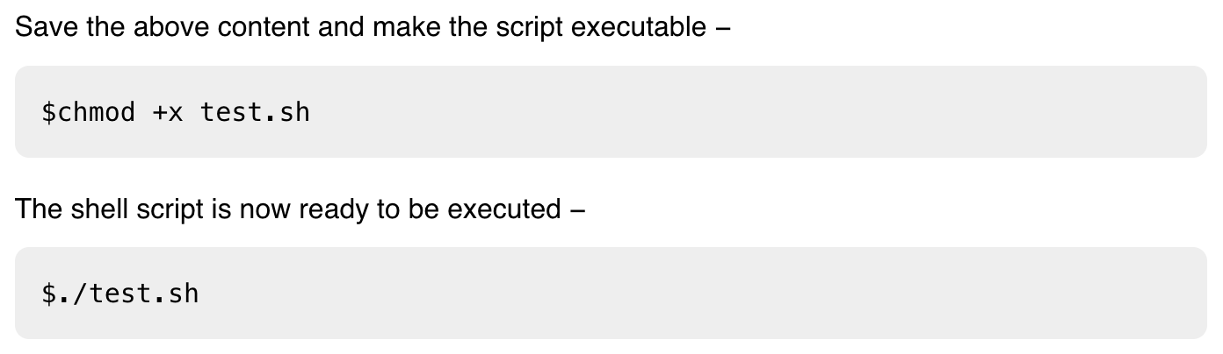
﻿Writing and Executing a Shell Script
Basics of shell scripts
  ﻿Write shell scripts using a text editor such as vi, vim, nano editor.
  Run in system-wide shell configuration: /etc/.bashrc
  Run in user profile in home directory: .bash_profile
  Run directly in shell. But require ﻿chmod +x to have execution permission

Slide 18
﻿Writing and Executing a Shell Script
Basics of shell scripts
  ﻿Beginning with shebang line (#!)
    #!/bin/sh: Will be run in the Bourne shell, sh
  Three types of variables:
    ﻿Environment variables: Variables will be part of the system environment, in your shell program.
    ﻿Built-in variables: ﻿Variables such as options used on the command. We cannot modify built-in variables.
    User variables: Define in script and can be only available with in the shell script.
    We don’t need to provide the type for variable

Slide 19
﻿Writing and Executing a Shell Script
Basics of shell scripts
  ﻿Initialize value for variables:
    ﻿lcount=0
    ﻿myname=“Sedona”
    Single quotes (‘) prevent shell from expanding variables
    ﻿Backtick (`) signals the shell to replace a string with its output when executed: ﻿var=`cat test.txt`
  Access the value of variables
    lcount =$var
  Positional Parameters:
    ﻿Passing options from the command line or from another shell script to your shell program is possible.
    ﻿$1 is the first parameter, $2 is the second parameter
    $0 The filename of the current script.

Slide 20
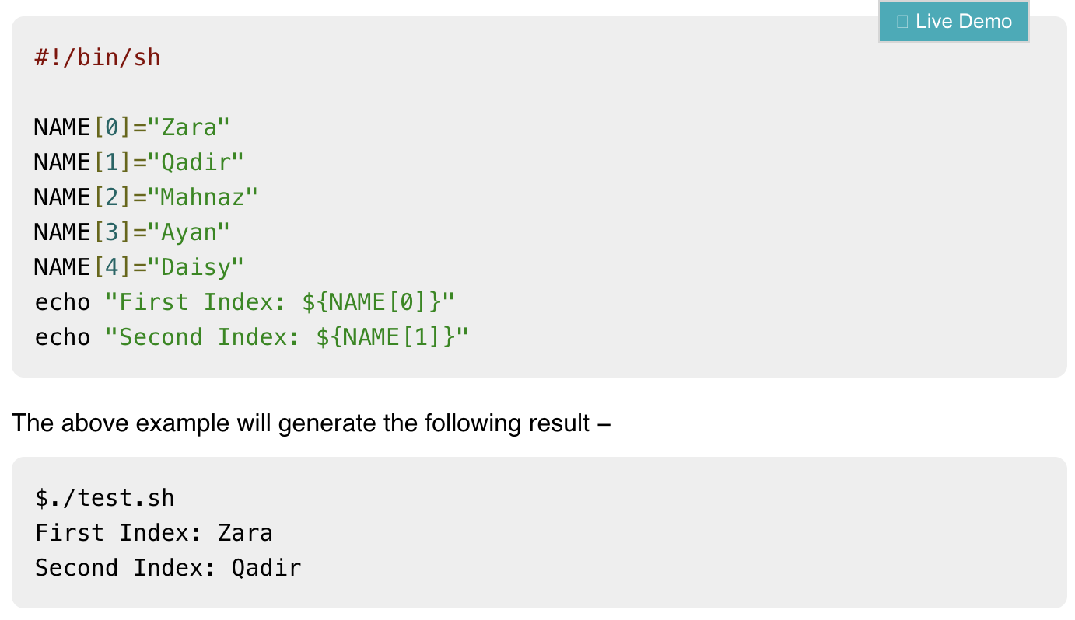
﻿Writing and Executing a Shell Script
Array
  Define array: array_name=(value1 ... valuen)
  Access value: ${array_name[index]}

Slide 21
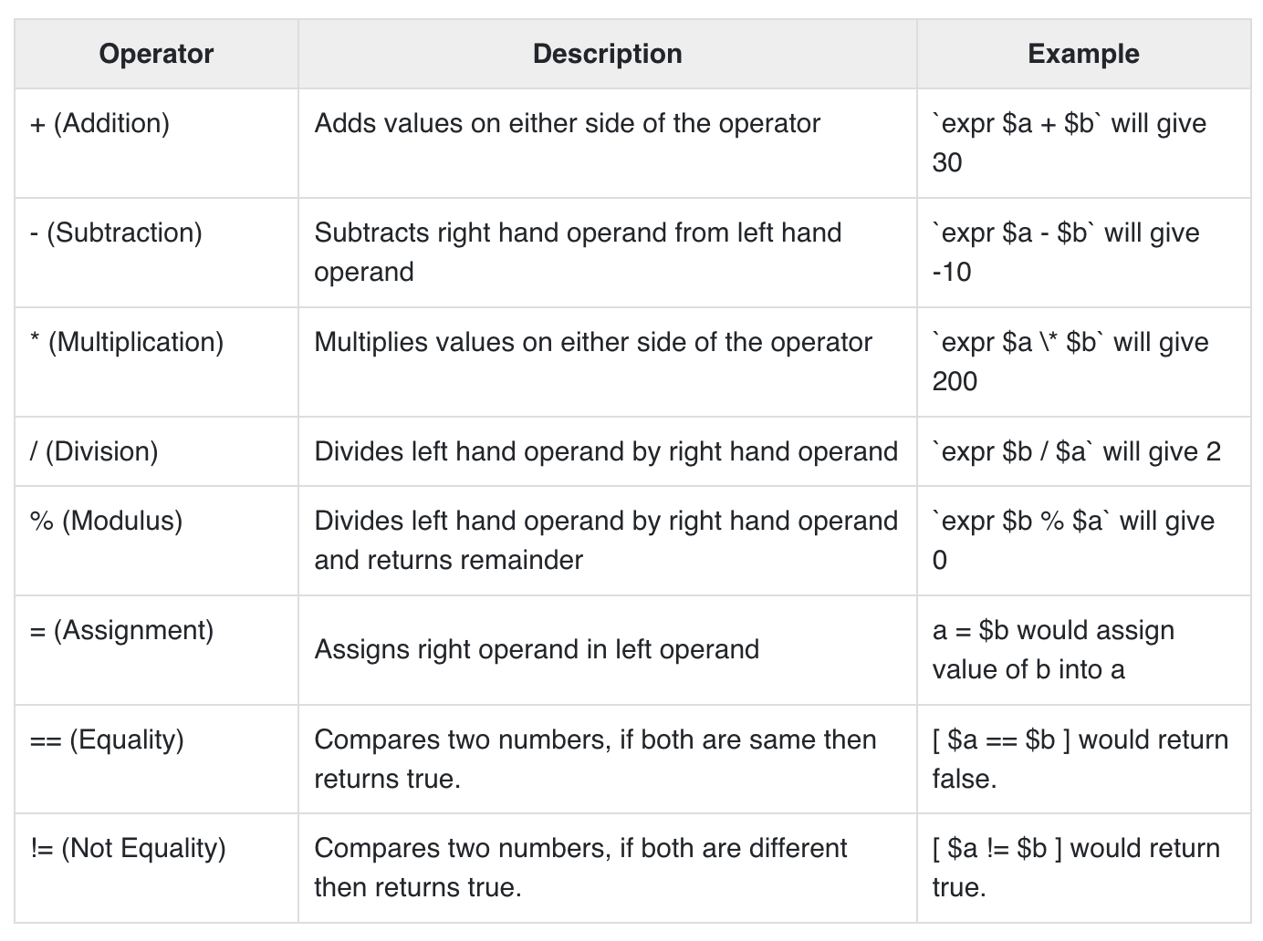
﻿Writing and Executing a Shell Script
Arithmetic Operators
https://www.tutorialspoint.com/unix/unix-basic-operators.htm

Slide 22
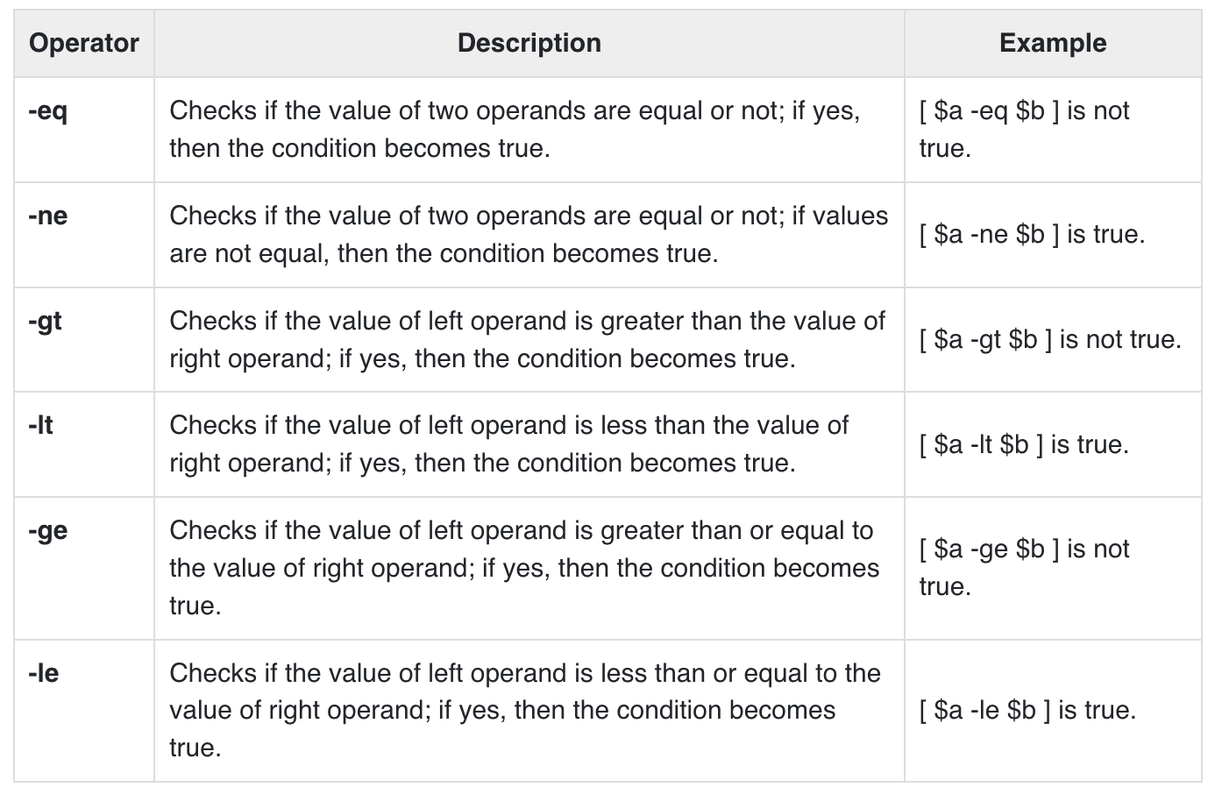
﻿Writing and Executing a Shell Script
Relational Operators
https://www.tutorialspoint.com/unix/unix-basic-operators.htm

Slide 23
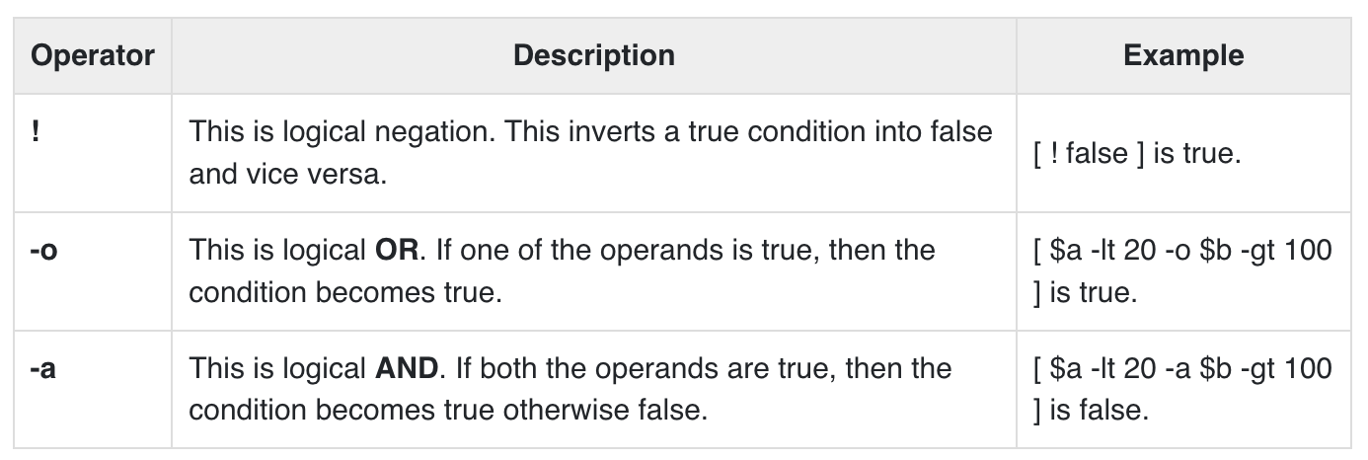
﻿Writing and Executing a Shell Script
Boolean Operators
https://www.tutorialspoint.com/unix/unix-basic-operators.htm

Slide 24
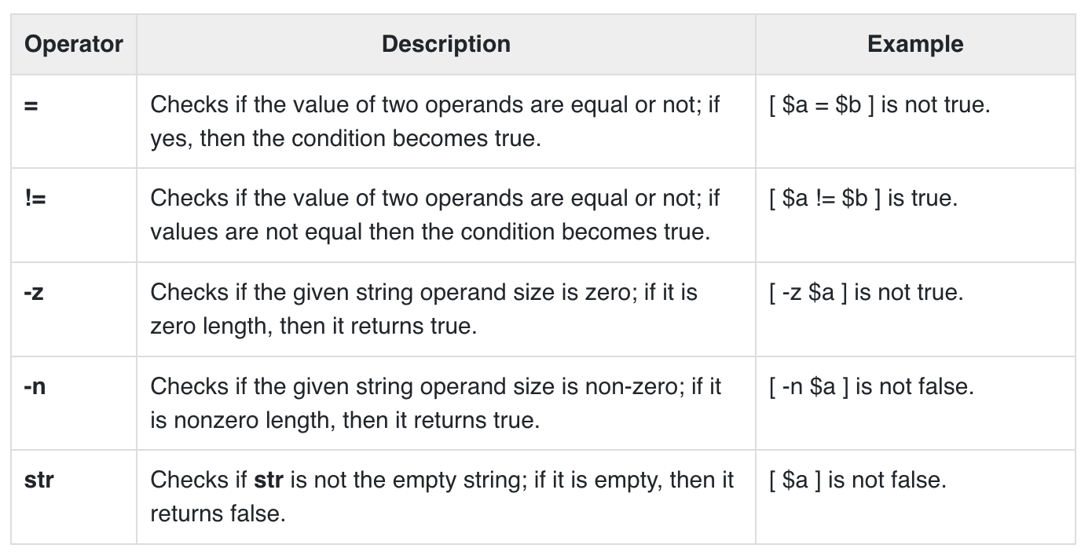
﻿Writing and Executing a Shell Script
String Operators
https://www.tutorialspoint.com/unix/unix-basic-operators.htm

Slide 25
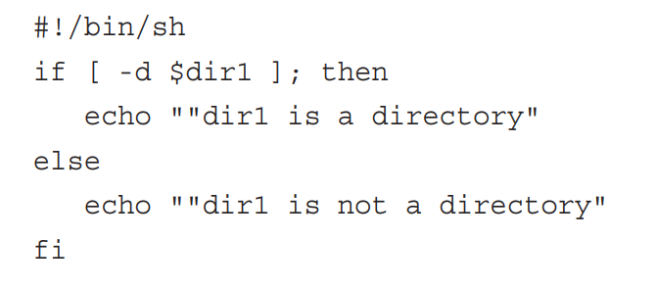
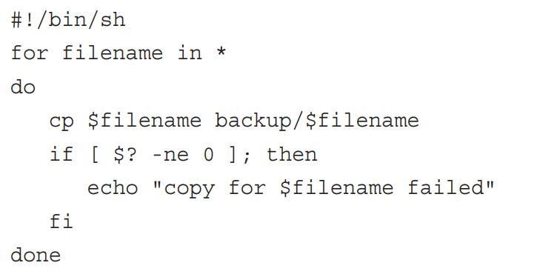
﻿Writing and Executing a Shell Script
Condition statements
  if...;then…fi statement
  if...;then…else...fi statement
  if...;then…elif...; then…else...fi statement
  case...in…esac statement
Loop controls:
  while expr do stats done
  for expr do stats done
  until expr do stats done
  break, continue
  exit: to quite the shell program
https://www.tutorialspoint.com/unix/unix-decision-making.htm
See further in Chapter 14 of Textbook

Slide 26
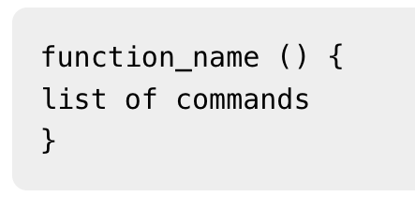
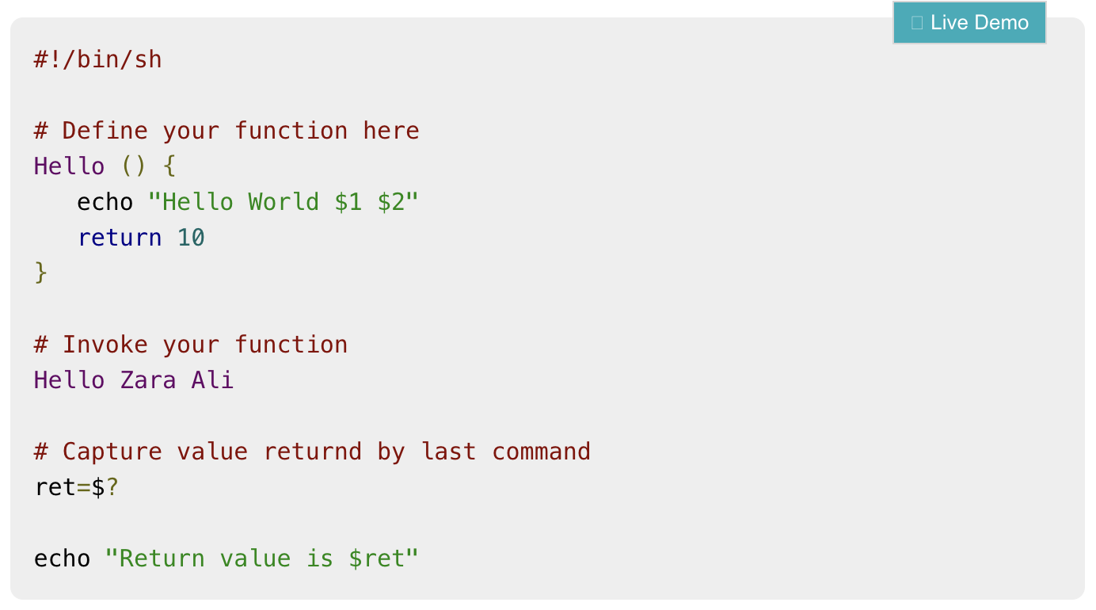
﻿Writing and Executing a Shell Script
Shell Functions
  Declare a function
  Example:
https://www.tutorialspoint.com/unix/unix-decision-making.htm

Slide 27
Remarks
Remarks:
  This lecturer provides fundamentals of shell scripting and important features for later chapters.
  Review chapter 14 in textbook
  https://www.tutorialspoint.com/unix/shell_scripting.htm
  Practice with example commands and scripting codes

